Slide 1

Colour sorting system
Name: Ben Thatcher
Login: BDT4

Slide 2
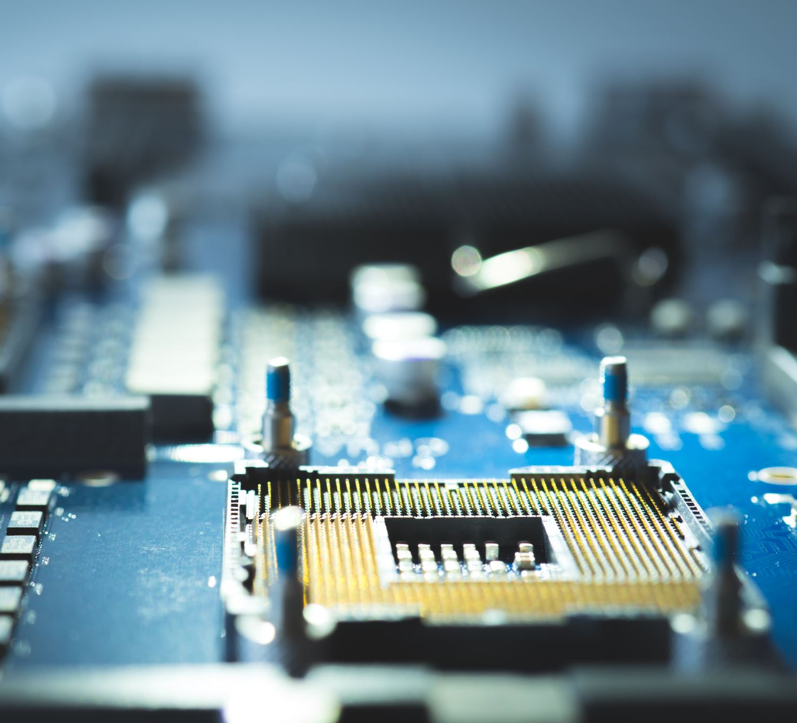
What components do we need?
TCS230 Colour sensor module
SG 90 mini servo
0.96” OLED screen
ATMega328P Arduino processor

Slide 3
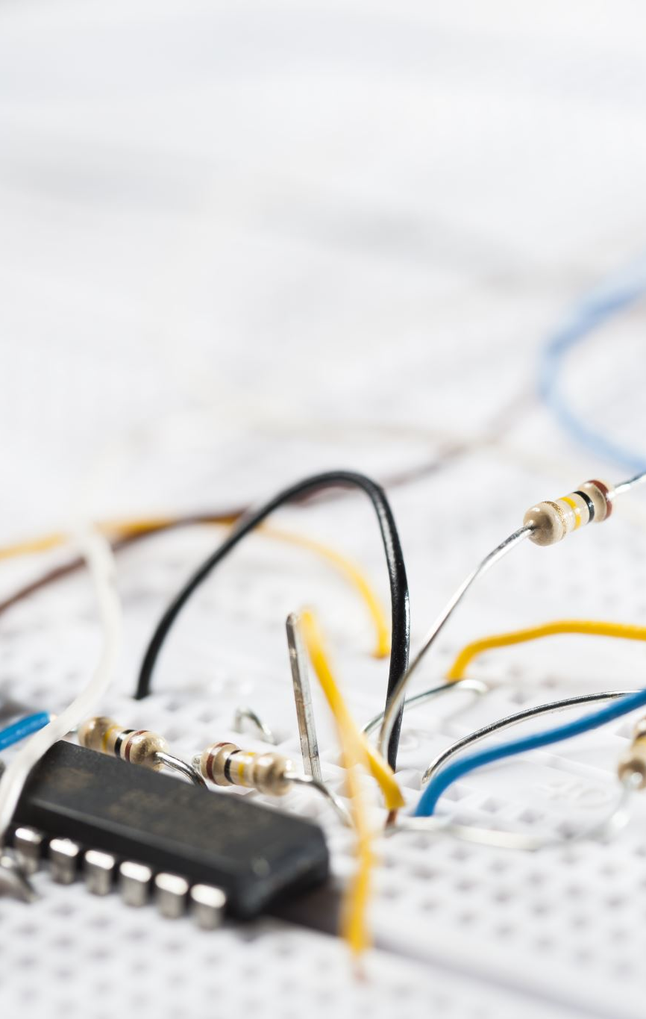
Hardware integration (problems)

Slide 4
Self reflection

